Slide 1
Predicting Septicemia Using MIMIC-III Dataset and DL Language Models
Team 3
Ivan Shu, Kelsey Luu and Taylor Shishido

Slide 2
Can we use language models trained on ICU clinical notes to predict if a patient has a sepsis-related ICD9 code?
Identify clinically significant patient subtypes
Can facilitate high throughput phenotyping for research use

Slide 3
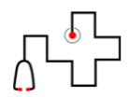

Dataset: ICU Radiology notes from MIMIC-III
164,230 radiology notes
N = 6,597 hospital-specific patients w/ 1+ sepsis ICD
"[**Last Name (LF) **],[**First Name3 (LF) **] EU [**2166-10-9**] 8:24 PM
CTA HEAD W&W/O C & RECONS; CTA NECK W&W/OC & RECONS Clip # [**Clip Number (Radiology) 38938**]
CT BRAIN PERFUSION; -59 DISTINCT PROCEDURAL SERVICE
Reason: eval for ICH/CVA
Contrast: OPTIRAY Amt: 110
______________________
[**Hospital 2**] MEDICAL CONDITION:
86 year old woman with new onset dysarthria, last known well at 1530
REASON FOR THIS EXAMINATION:
eval for ICH/CVA
No contraindications for IV contrast
_____________________________________________
PFI REPORT
1. No evidence of acute infarct, or intracranial hemorrhage in brain.
2. No evidence of focal flow-limiting stenosis, occlusion, or aneurysm greater than 3 mm in arteries of anterior and posterior circulation of head.
3. Calcified plaque at the left distal common carotid artery causing approximately 25% stenosis.
2 OUTCOMES:
Binary: presence of a sepsis ICD
Multiclass: number of ICDs assigned
N = 6,597 hospital-specific patients w/ 0 ICDs (case-balanced)
MIMIC-III: a freely accessible critical care database (2016), Johnson et al.

Slide 4
Dataset: Text preprocessing
Patient shows up in only test, tr, or split
ICDs are not note-specific*
[**Hospital 2**] MEDICAL CONDITION:
86 year old woman with new onset dysarthria, last known well at 1530
REASON FOR THIS EXAMINATION:
eval for ICH/CVA
No contraindications for IV contrast
_____________________________________________
PFI REPORT
1. No evidence of acute infarct, or intracranial hemorrhage in brain.
2. No evidence of focal flow-limiting stenosis, occlusion, or aneurysm greater than 3 mm in arteries of anterior and posterior circulation of head.
3. Calcified plaque at the left distal common carotid artery causing approximately 25% stenosis.
['pleural', 'asp', 'radiologist', 'right', 'guidance', 'female', 'first', 'name', 'un', 'centesis', 'usclip', 'telephonefax', 'chest', 'u', 'reason', 'fever', 'r', 'side', 'pleural', 'effusion', 'procedure', 'approve', 'hospital', 'medical', 'condition', 'year', 'old', 'woman', 'sp', 'sahsdh', 'pleural' …]
6 MODELS:
Bag of Words
Word2Vec
LSTM
CNN
DistilBERT
ClinicalBERT

Slide 5
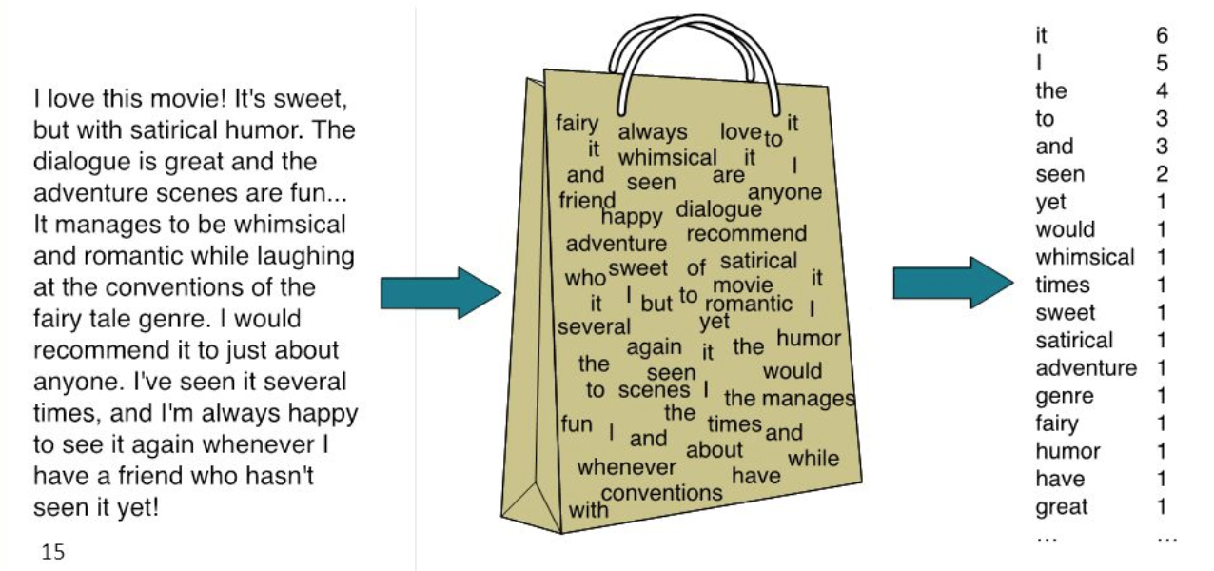
Bag of Words and Word2Vec: no sequence data
B.O.W. : similar to dimension reduction, create latent variables from patterns of term frequency in notes
Word2Vec: learns embedding of a words based on close neighbors
Clinical note embedding = an average of all its word embeddings
Learn context → gain semantic understanding
['pleural', 'asp', 'radiologist', 'right', 'guidance', 'female', 'first', 'name', 'un', 'centesis',...
An introduction to latent semantic analysis (2009), Landauer et al.
Efficient Estimation of Word Representations in Vector Space (2013) , Mikolov et al.

Slide 6
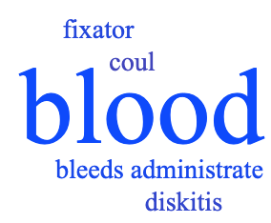
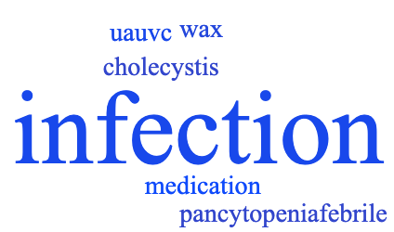
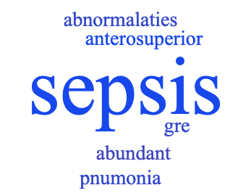
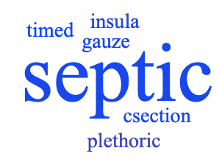
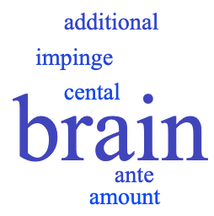
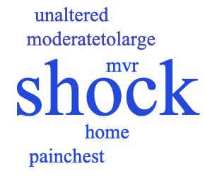
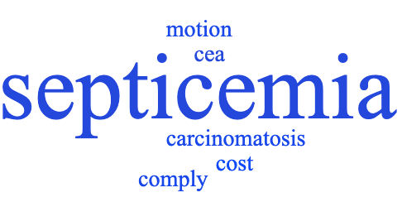
Word2Vec: Similar word embeddings

Slide 7
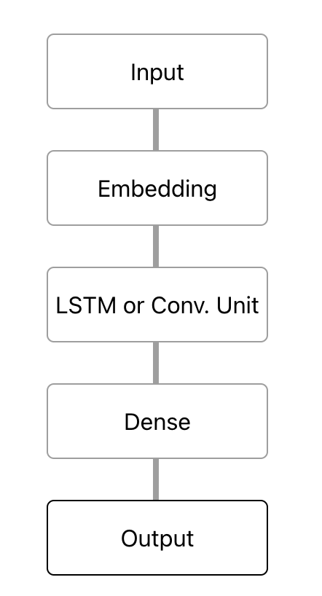
Basic Neural Networks
LSTM - recurrent model learns sequential patterns
CNN - convolutional filters learn translationally invariant features
Embedding layer for feature extraction
Pro: Quick training/convergence
Probability of sepsis

Slide 8
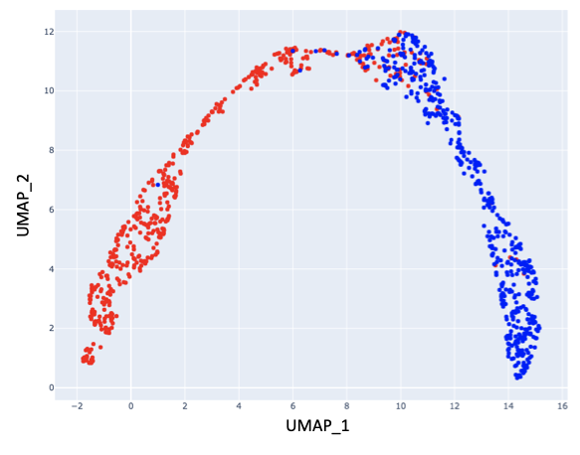

Basic Neural Networks - Embedding Visualization
1 point = 1 radiology note
Class separation by LSTM embeddings

Slide 9


BERT (Bidirectional Encoder Representations from Transformers)
DistilBERT
Bio_ClinicalBERT
Features: 1. Light-weight 2. Pre-trained on English wikipedia
Features: 1. Deep Network 2. Pre-trained on MIMIC-III Notes
Publicly Available Clinical Embeddings (2019), Alsentzer et al.
ClinicalBERT: Modeling Clinical Notes and Predicting Hospital Readmission (2020), Huang et al.

Slide 10
DistilBERT and Clinical BERT on Binary Outcome
DistilBERT | Accuracy | Precision | Recall | F1 | AUC | Time | # param
Train set | 0.96128 | 0.97258 | 0.94969 | 0.96100 | 0.95446 | 81.10 | 66,955,010
Val set | 0.84363 | 0.87501 | 0.80507 | 0.83858 | 0.81807 | 81.10 | 66,955,010
Test set | 0.83107 | 0.86399 | 0.77834 | 0.81893 | 0.83071 | 81.10 | 66,955,010
ClinicalBERT | Accuracy | Precision | Recall | F1 | AUC | Time | # param
Train set | 0.96747 | 0.98187 | 0.95281 | 0.96712 | 0.96753 | 85.04 | 108,310,272
Val set | 0.84303 | 0.86251 | 0.81872 | 0.84004 | 0.84319 | 85.04 | 108,310,272
Test set | 0.82633 | 0.85140 | 0.78228 | 0.81538 | 0.82548 | 85.04 | 108,310,272

Slide 11
DistilBERT and Clinical BERT on Multi-Class
Outcome
DistilBERT | Accuracy | Precision | Recall | F1 | AUC | Time | # param
Train set | 0.49770 | 0.48760 | 0.48734 | 0.48746 | N/A | 97.74 | 66,955,010
Val set | 0.49548 | 0.49335 | 0.48992 | 0.49162 | N/A | 97.74 | 66,955,010
Test set | 0.50917 | 0.50025 | 0.50446 | 0.50234 | N/A | 97.74 | 66,955,010
ClinicalBERT | Accuracy | Precision | Recall | F1 | AUC | Time | # param
Train set | 0.97369 | 0.99064 | 0.95664 | 0.97334 | N/A | 81.00 | 108,310,272
Val set | 0.84333 | 0.87940 | 0.79829 | 0.83688 | N/A | 81.00 | 108,310,272
Test set | 0.82279 | 0.86264 | 0.75946 | 0.80776 | N/A | 81.00 | 108,310,272

Slide 12
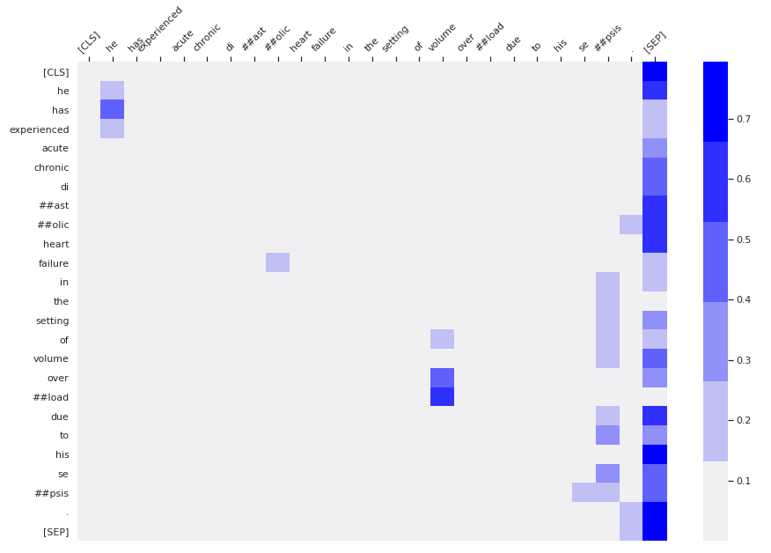
Clinical BERT Attention Heads Visualization
"he has experienced acute chronic diastolic heart failure in the setting of volume overload due to his sepsis."

Slide 13
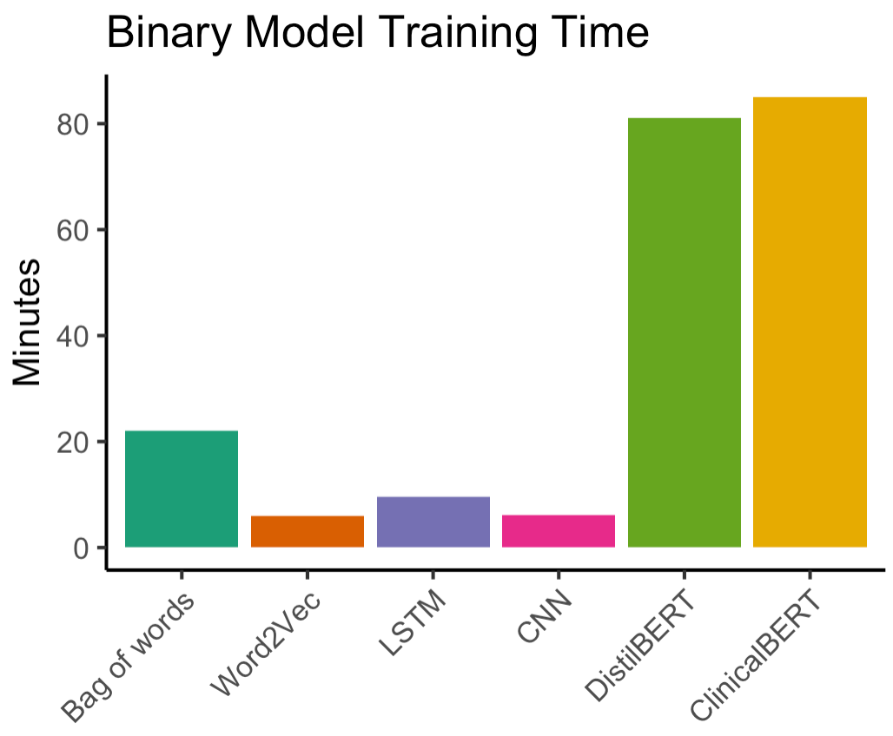
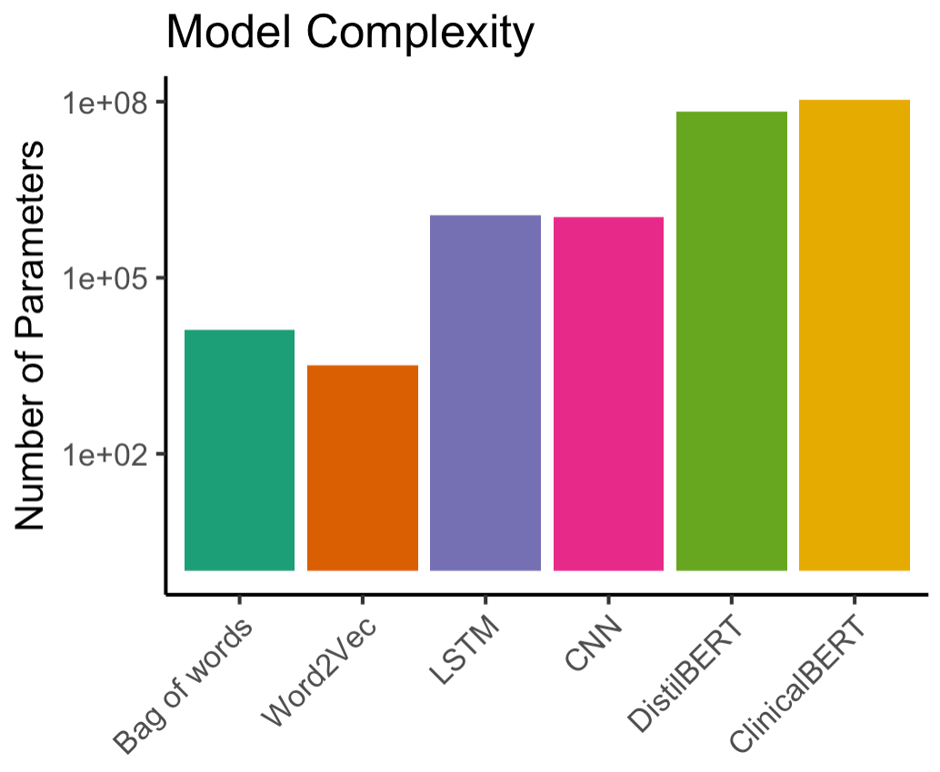
Models Summary on Test Set Binary Outcome

Slide 14
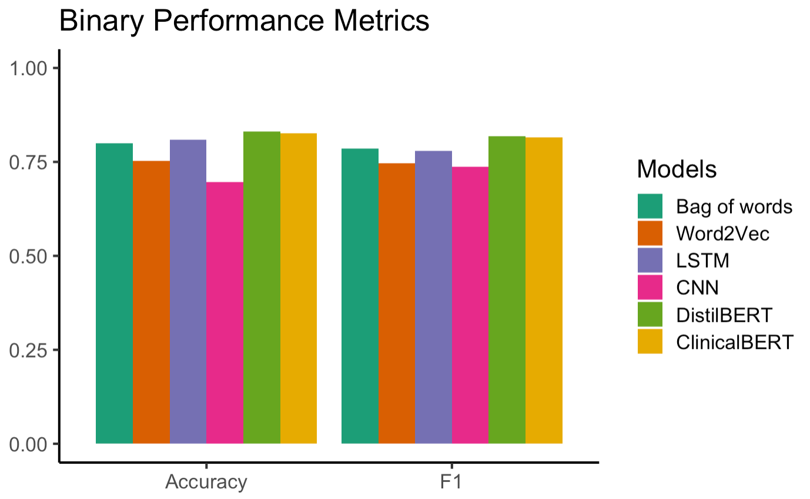
Models Summary on Test Set Binary Outcome

Slide 15
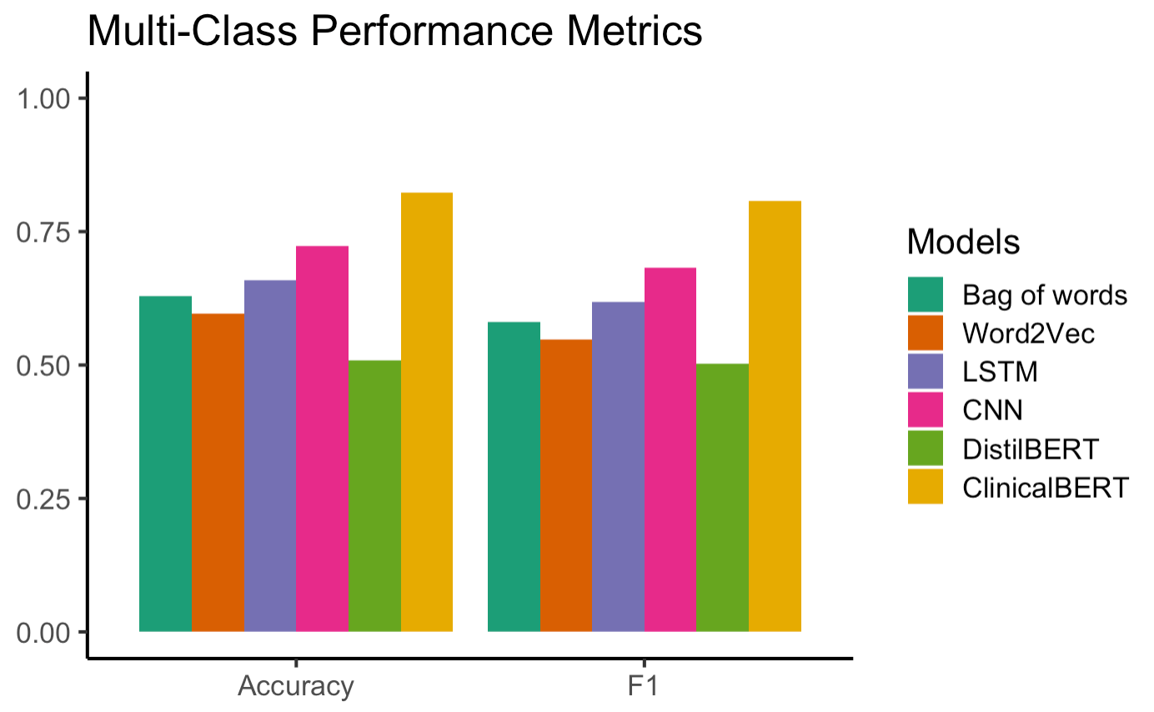
Models Summary on Test Set Multi-Class Outcome

Slide 16
Challenges, Model Implications and Future Directions
Models are built upon Retrospective Data.
Generalizability to other institution ICU data.
Cluster notes to identify disease subtypes.
Saliency mapping of input tokens.
Predict the presence of individual sepsis-related ICD codes.

Slide 17
Supplementary Slides

Slide 18
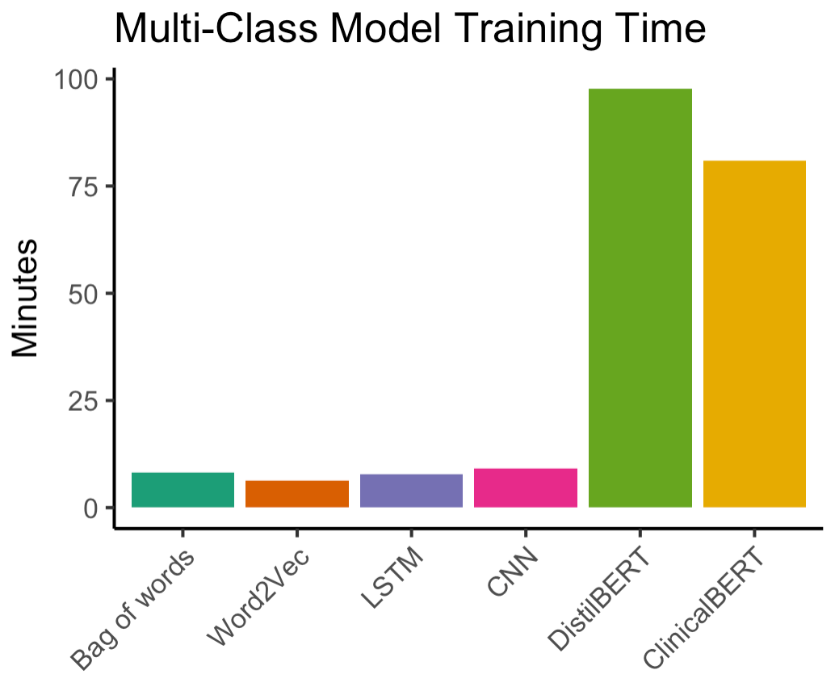
Models Summary on Test Set Multi-Class Outcome

Slide 19
Models Summary on Test Set Binary Outcome
Models | Accuracy | Precision | Recall | F1 | AUC | Time | # Params
Bag of words | 0.800 | 0.825 | 0.751 | 0.786 | 0.881 | 22.05m | 12,857
Word2Vec | 0.752 | 0.749 | 0.742 | 0.746 | 0.833 | 6.05m | 3,257
LSTM | 0.80897 | 0.89758 | 0.68894 | 0.77954 | 0.89289 | 7.72m | 1,151,914
CNN | 0.69621 | 0.6395 | 0.87174 | 0.73778 | 0.80942 | 9.07m | 1,065,002
DistilBERT | 0.83107 | 0.86399 | 0.77834 | 0.81893 | 0.83071 | 81.10m | 66,955,010
ClinicalBERT | 0.82633 | 0.85140 | 0.78228 | 0.81538 | 0.82548 | 85.04m | 108,310,272

Slide 20
Models Summary on Test Set Multi-Class Outcome
Models | Accuracy | Precision | Recall | F1 | Time | # Params
Bag of words | 0.629 | 0.736 | 0.480 | 0.581 | 8.23m | 13,022
Word2Vec | 0.596 | 0.707 | 0.448 | 0.548 | 6.35m | 3,257
LSTM | 0.659 | 0.745 | 0.529 | 0.619 | 7.72m | 1,151,914
CNN | 0.723 | 0.813 | 0.588 | 0.683 | 9.07m | 1,1065,002
DistilBERT | 0.50917 | 0.50025 | 0.50446 | 0.50234 | 97.74m | 66,955,010
ClinicalBERT | 0.82279 | 0.86264 | 0.75946 | 0.80776 | 81.00m | 108,310,272

